Slide 1
JavaFX
Abhishek S. Rao

Slide 2
JavaFX Overview
Rich Internet Applications are those web applications which provide similar features and experience as that of desktop applications. They offer a better visual experience when compared to the normal web applications to the users. These applications are delivered as browser plug-ins or as a virtual machine and are used to transform traditional static applications into more enhanced, fluid, animated and engaging applications.
Unlike traditional desktop applications, RIA’s don’t require to have any additional software to run. As an alternative, you should install software such as ActiveX, Java, Flash, depending on the Application.
In an RIA, the graphical presentation is handled on the client side, as it has a plugin that provides support for rich graphics. In a nutshell, data manipulation in an RIA is carried out on the server side, while related object manipulation is carried out on the client side.

Slide 3
We have three main technologies using which we can develop an RIA. These include the following:
Adobe Flash
Microsoft Silverlight
JavaFX
Adobe Flash
This software platform is developed by Adobe Systems and is used in creating Rich Internet Applications. Along with these, you can also build other Applications such as Vector, Animation, Browser Games, Desktop Applications, Mobile Applications and Games, etc.
This is the most commonly used platform for developing and executing RIA’s with a desktop browser penetration rate of 96%.
Microsoft Silverlight
Just like Adobe flash, Microsoft Silverlight is also a software application framework for developing as well as executing Rich Internet Applications. Initially this framework was used for streaming media. The present versions support multimedia, graphics, and animation as well.
This platform is rarely used with a desktop browser penetration rate of 66%.

Slide 4
JavaFX
JavaFX is a Java library using which you can develop Rich Internet Applications. By using Java technology, these applications have a browser penetration rate of 76%.
JavaFX is a Java library used to build Rich Internet Applications. The applications written using this library can run consistently across multiple platforms. The applications developed using JavaFX can run on various devices such as Desktop Computers, Mobile Phones, TVs, Tablets, etc.
To develop GUI Applications using Java programming language, the programmers rely on libraries such as Advanced Windowing Toolkit and Swings. After the advent of JavaFX, these Java programmers can now develop GUI applications effectively with rich content.

Slide 5
Need of JavaFX
To develop Client-Side Applications with rich features, the programmers used to depend on various libraries to add features such as Media, UI controls, Web, 2D and 3D, etc. JavaFX includes all these features in a single library. In addition to these, the developers can also access the existing features of a Java library such as Swings.
JavaFX provides a rich set of graphics and media API’s and it leverages the modern Graphical Processing Unit through hardware accelerated graphics. JavaFX also provides interfaces using which developers can combine graphics animation and UI control.
One can use JavaFX with JVM based technologies such as Java, Groovy and JRuby. If developers opt for JavaFX, there is no need to learn additional technologies, as prior knowledge of any of the above-mentioned technologies will be good enough to develop RIA’s using JavaFX.

Slide 6
Features of JavaFX
Following are some of the important features of JavaFX –
Written in Java: The JavaFX library is written in Java and is available for the languages that can be executed on a JVM, which include – Java, Groovy and JRuby. These JavaFX applications are also platform independent.
FXML: JavaFX features a language known as FXML, which is a HTML like declarative markup language. The sole purpose of this language is to define a user Interface.
Scene Builder: JavaFX provides an application named Scene Builder. On integrating this application in IDE’s such as Eclipse and NetBeans, the users can access a drag and drop design interface, which is used to develop FXML applications (just like Swing Drag & Drop and DreamWeaver Applications).

Slide 7
Swing Interoperability: In a JavaFX application, you can embed Swing content using the Swing Node class. Similarly, you can update the existing Swing applications with JavaFX features like embedded web content and rich graphics media.
Built-in UI controls: JavaFX library caters UI controls using which we can develop a full-featured application.
CSS like Styling: JavaFX provides a CSS like styling. By using this, you can improve the design of your application with a simple knowledge of CSS.
Canvas and Printing API: JavaFX provides Canvas, an immediate mode style of rendering API. Within the package javafx.scene.canvas it holds a set of classes for canvas, using which we can draw directly within an area of the JavaFX scene. JavaFX also provides classes for Printing purposes in the package javafx.print.

Slide 8
Rich set of API’s: JavaFX library provides a rich set of API’s to develop GUI applications, 2D and 3D graphics, etc. This set of API’s also includes capabilities of Java platform. Therefore, using this API, you can access the features of Java languages such as Generics, Annotations, Multithreading, and Lambda Expressions. The traditional Java Collections library was enhanced and concepts like observable lists and maps were included in it. Using these, the users can observe the changes in the data models.
Integrated Graphics library: JavaFX provides classes for 2d and 3d graphics.
Graphics pipeline: JavaFX supports graphics based on the Hardware-accelerated graphics pipeline known as Prism. When used with a supported Graphic Card or GPU it offers smooth graphics. In case the system does not support graphic card then prism defaults to the software rendering stack.

Slide 9
History of JavaFX
JavaFX was originally developed by Chris Oliver, when he was working for a company named See Beyond Technology Corporation, which was later acquired by Sun Microsystems in the year 2005.
The following points give us more information of this project:
Initially this project was named as F3 (Form Follows Functions) and it was developed with an intention to provide richer interfaces for developing GUI Applications.
Sun Microsystems acquired the See Beyond company in June 2005, it adapted the F3 project as JavaFX.
In the year 2007, JavaFX was announced officially at Java One, a world wide web conference which is held yearly.

Slide 10
History of JavaFX
In the year 2008, Net Beans integrated with JavaFX was available. In the same year, the Java Standard Development Kit for JavaFX 1.0 was released.
In the year 2009, Oracle Corporation acquired Sun Microsystems and in the same year the next version of JavaFX (1.2) was released as well.
In the year 2010, JavaFX 1.3 came out and in the year 2011 JavaFX 2.0 was released.
The latest version, JavaFX8, was released as an integral part of Java on 18th of March 2014.

Slide 11
JavaFX Basic Concepts
In general, the JavaFX framework has all of the good features of Swing. For example, JavaFX is lightweight. It can also support an MVC architecture.
JavaFX offers a more streamlined, easier-to-use, and use updated approach.
JavaFX also greatly simplifies the rendering of objects because it handles repainting automatically. It is no longer necessary for your program to handle this task manually.
The JavaFX Packages:
The JavaFX elements are contained in packages that begin with the javafx prefix. At the time of this writing, there are more than 30 JavaFX packages in its API library. Here are four examples: javafx.application, javafx.stage, javafx.scene, and javafx.scene.layout. JavaFX offers a wide array of functionality. Beginning with JDK 9, the JavaFX packages are organized into modules, such as javafx.base, javafx.graphics, and javafx.controls.

Slide 12
The Stage and Scene Classes
The central metaphor implemented by JavaFX is the stage. As in the case of an actual stage play, a stage contains a scene. Thus, loosely speaking, a stage defines a space and a scene defines what goes in that space. Or, put another way, a stage is a container for scenes and a scene is a container for the items that comprise the scene. As a result, all JavaFX applications have at least one stage and one scene. These elements are encapsulated in the JavaFX API by the Stage and Scene classes. To create a JavaFX application, you will, at minimum, add at least one Scene object to a Stage.
Stage is a top-level container. All JavaFX applications automatically have access to one Stage, called the primary stage. The primary stage is supplied by the run-time system when a JavaFX application is started. Although you can create other stages, for many applications, the primary stage will be the only one required. As mentioned, Scene is a container for the items that comprise the scene. These can consist of controls, such as push buttons and check boxes, text, and graphics. To create a scene, you will add those elements to an instance of Scene.

Slide 13
Nodes and Scene Graphs
The individual elements of a scene are called nodes. For example, a push button control is a node. However, nodes can also consist of groups of nodes. Furthermore, a node can have a child node. In this case, a node with a child is called a parent node or branch node. Nodes without children are terminal nodes and are called leaves. The collection of all nodes in a scene creates what is referred to as a scene graph, which comprises a tree.
There is one special type of node in the scene graph, called the root node. This is the top-level node and is the only node in the scene graph that does not have a parent. Thus, with the exception of the root node, all other nodes have parents, and all nodes either directly or indirectly descend from the root node.
The base class for all nodes is Node. There are several other classes that are, either directly or indirectly, subclasses of Node. These include Parent, Group, Region, and Control, to name a few.

Slide 14
Layouts
JavaFX provides several layout panes that manage the process of placing elements in a scene.
For example, the FlowPane class provides a flow layout and the GridPane class supports a row/column grid-based layout. Several other layouts, such as BorderPane (which is similar to the AWT’s BorderLayout), are available. The layout panes are packaged in javafx.scene.layout.

Slide 15
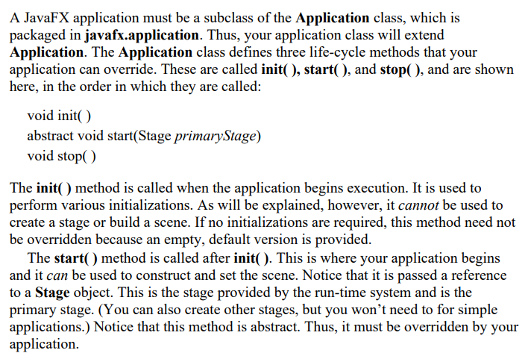
The Application Class and the Life-cycle Methods

Slide 16
When your application is terminated, the stop( ) method is called. It is here that you can handle any cleanup or shutdown chores. In cases in which no such actions are needed, an empty, default version is provided. One other point: For a modular JavaFX application, the package that contains your main application class (that is, your subclass of Application) must be exported by its module so that it can be found by the javafx.graphics module

Slide 17
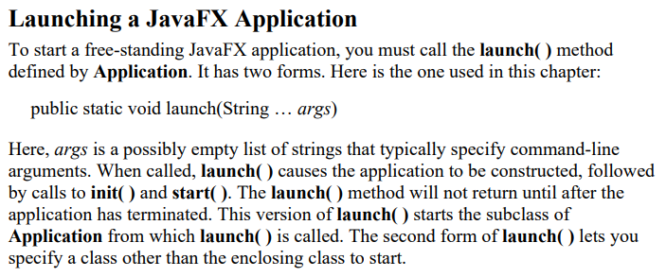

Slide 18
A JavaFX Application Skeleton
All JavaFX applications share the same basic skeleton. Therefore, before looking at any more JavaFX features, it will be useful to see what that skeleton looks like. In addition to showing the general form of a JavaFX application, the skeleton also illustrates how to launch the application and demonstrates when the life-cycle methods are called. A message noting when each life-cycle method is called is displayed on the console.

Slide 19
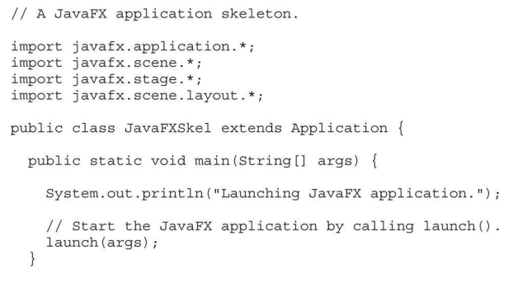

Slide 20
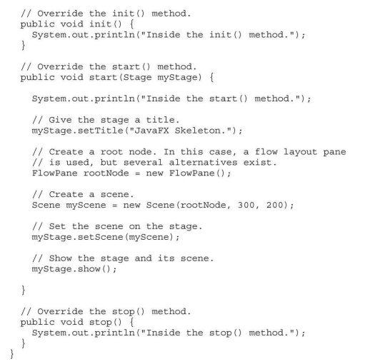

Slide 21
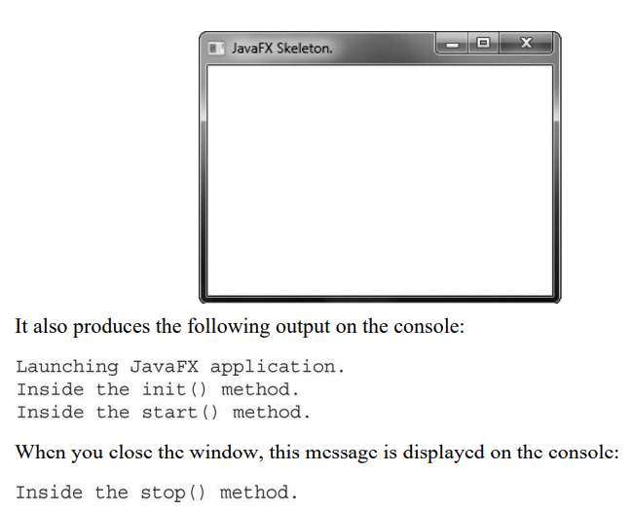

Slide 22
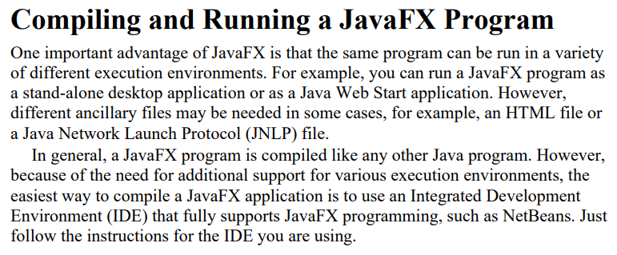

Slide 23
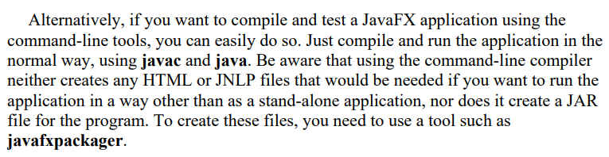

Slide 24
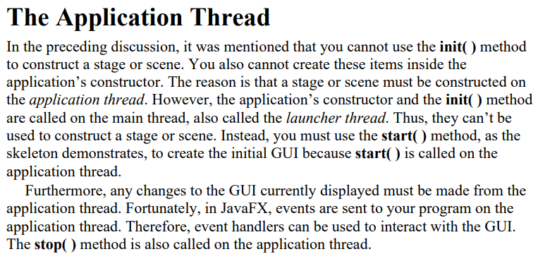

Slide 25
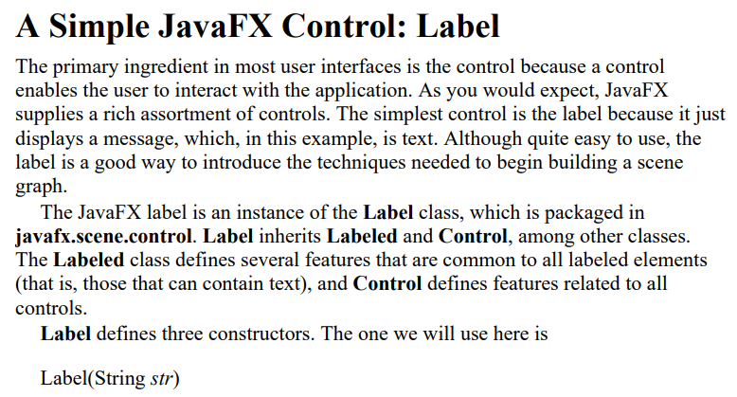

Slide 26
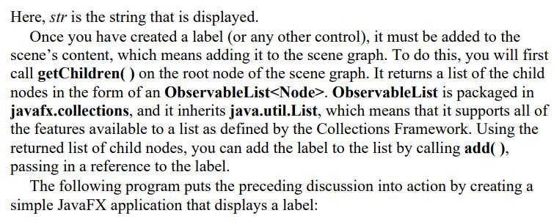

Slide 27
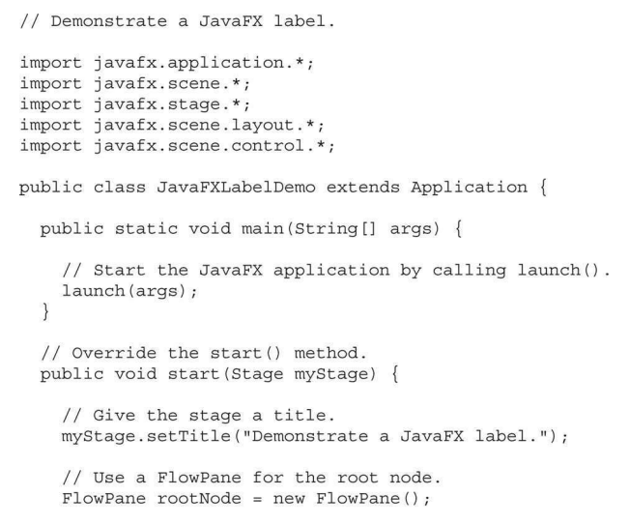

Slide 28
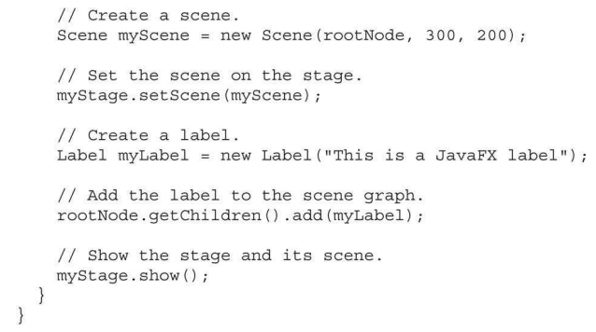

Slide 29
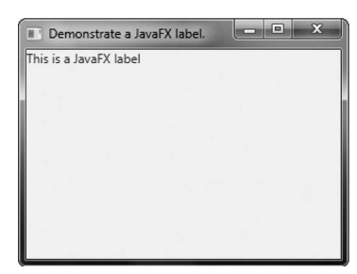

Slide 30
Using Buttons and Events
Although the program in the preceding section presents a simple example of using a JavaFX control and constructing a scene graph, it does not show how to handle events. As you know, most GUI controls generate events that are handled by your program.
For example, buttons, check boxes, and lists all generate events when they are used. In many ways, event handling in JavaFX is similar to event handling in Swing or the AWT, but it’s more streamlined. Therefore, if you already are proficient at handling events for these other two GUIs, you will have no trouble using the event handling system provided by JavaFX.
One commonly used control is the button. This makes button events one of the most frequently handled. Therefore, a button is a good way to demonstrate the fundamentals of event handling in JavaFX. For this reason, the fundamentals of event handling and the button are introduced together

Slide 31
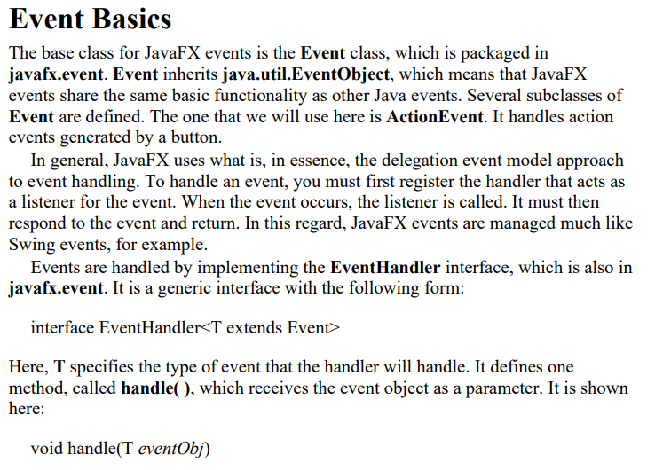

Slide 32
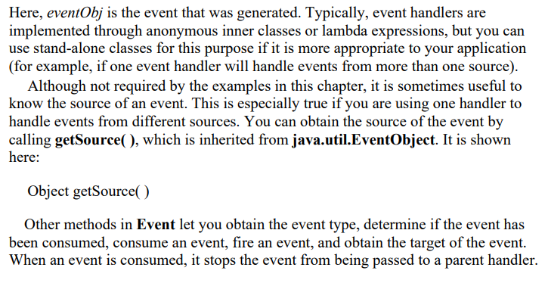

Slide 33
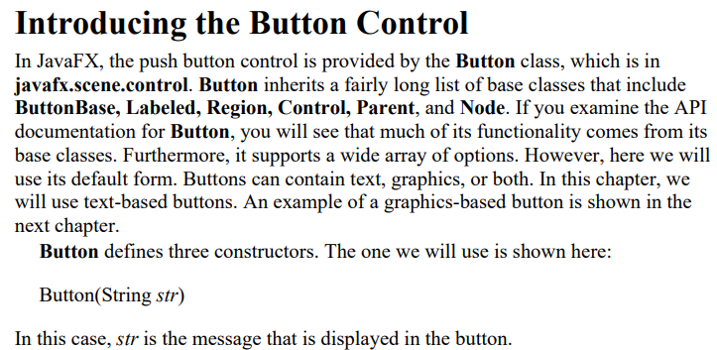

Slide 34
When a button is pressed, an ActionEvent is generated. ActionEvent is packaged in javafx.event. You can register a listener for this event by using setOnAction( ), which has this general form:
final void setOnAction(EventHandler handler)
Here, handler is the handler being registered. As mentioned, often you will use an anonymous inner class or lambda expression for the handler. The setOnAction( ) method sets the property onAction, which stores a reference to the handler. As with all other Java event handling, your handler must respond to the event as fast as possible and then return. If your handler consumes too much time, it will noticeably slow down the application. For lengthy operations, you must use a separate thread of execution.

Slide 35
Demonstrating Event Handling and the Button The following program demonstrates event handling. It uses two buttons and a label. Each time a button is pressed, the label is set to display which button was pressed.

Slide 36
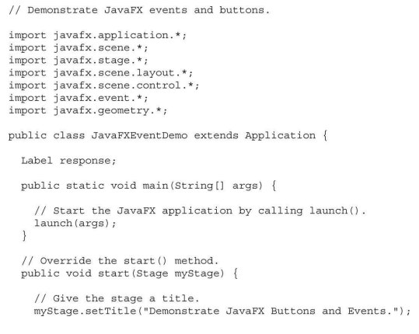

Slide 37
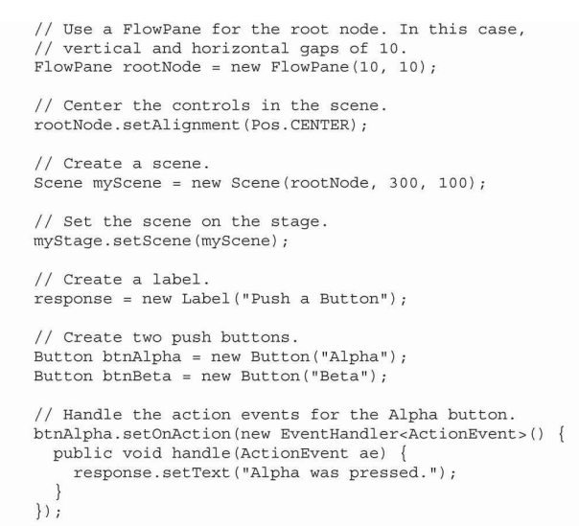

Slide 38
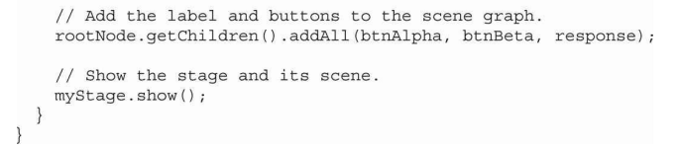
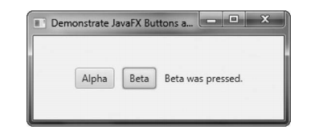

Slide 39
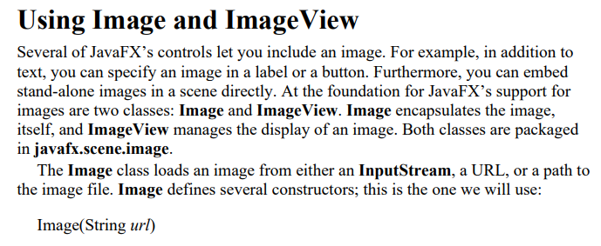

Slide 40
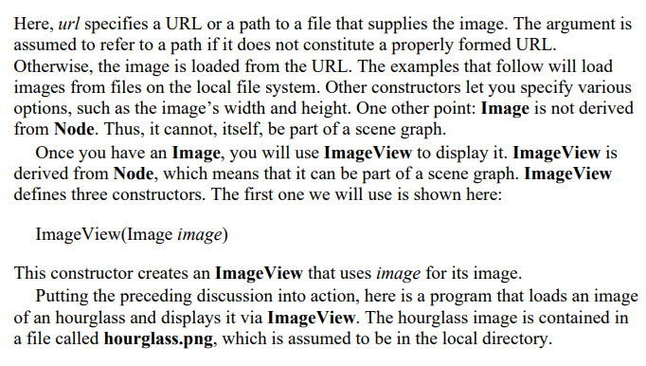

Slide 41
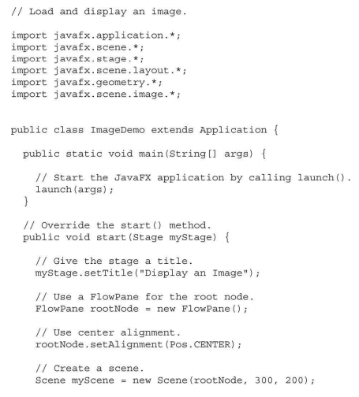

Slide 42
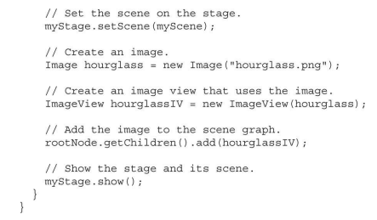

Slide 43
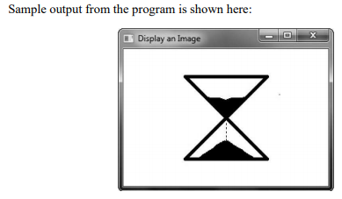

Slide 44
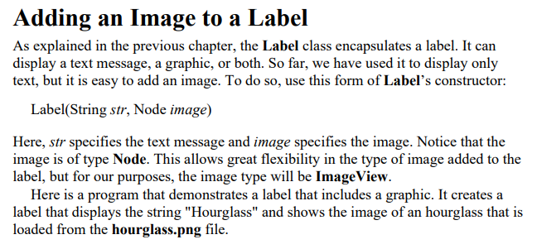

Slide 45
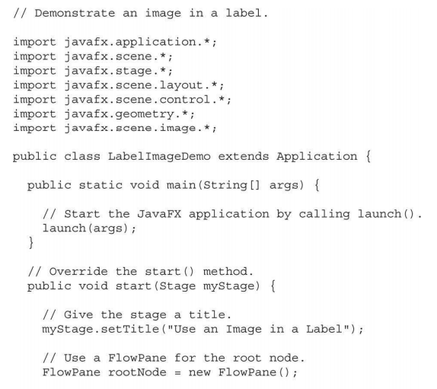

Slide 46
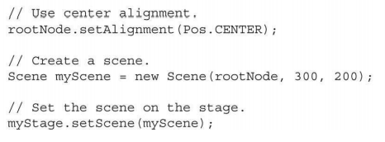

Slide 47
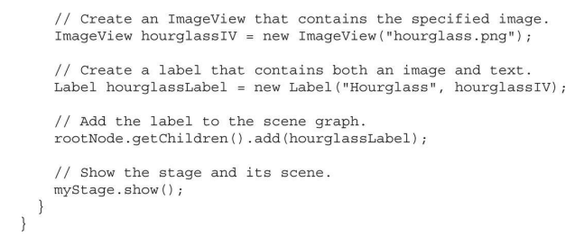
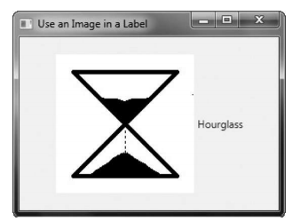

Slide 48
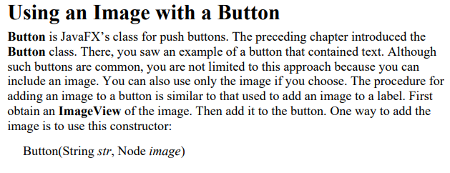
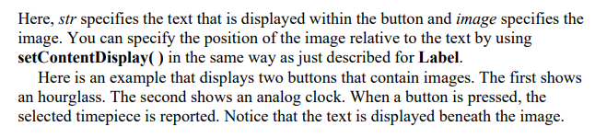

Slide 49
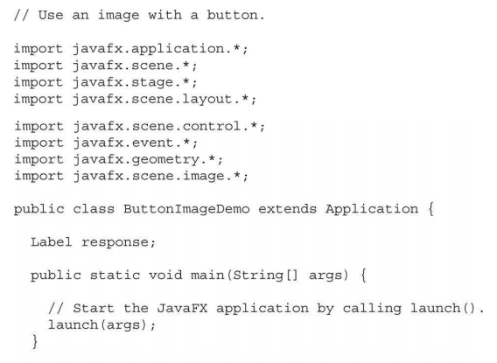

Slide 50
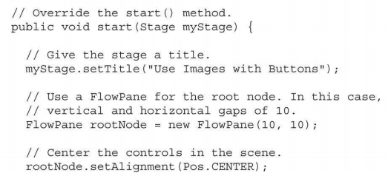

Slide 51
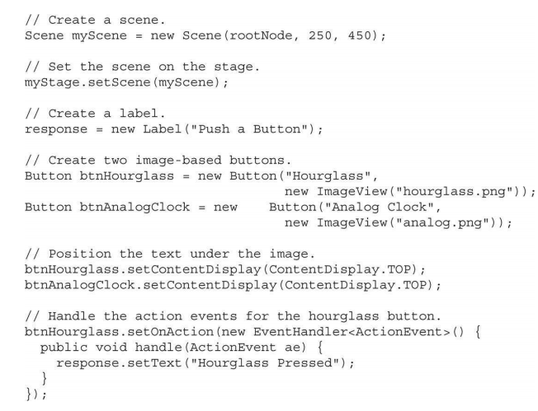

Slide 52
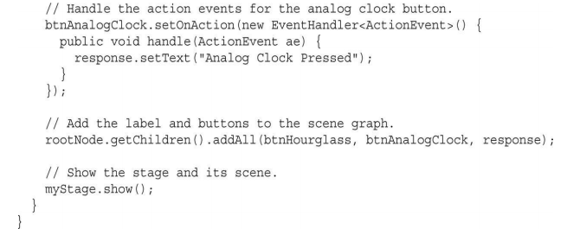

Slide 53
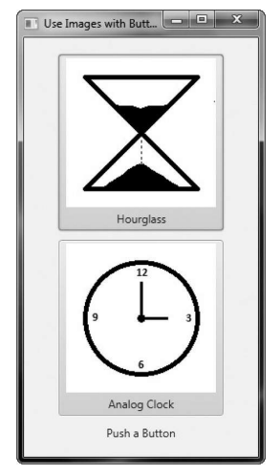

Slide 54
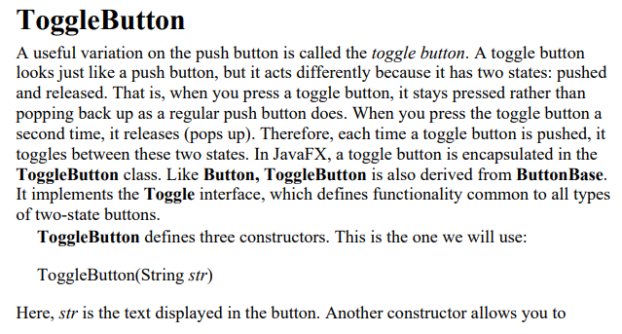

Slide 55
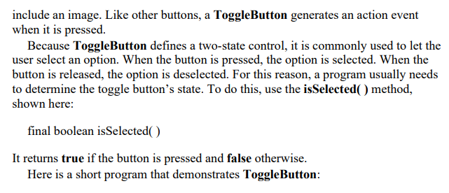

Slide 56
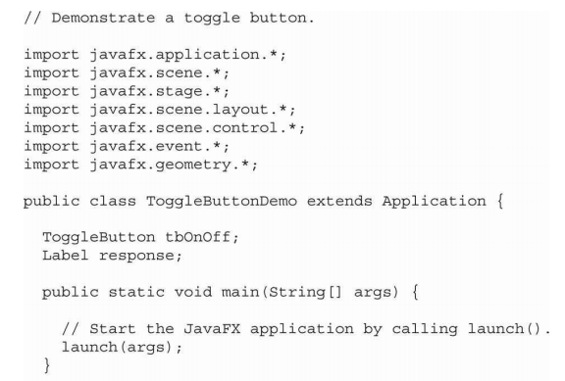

Slide 57
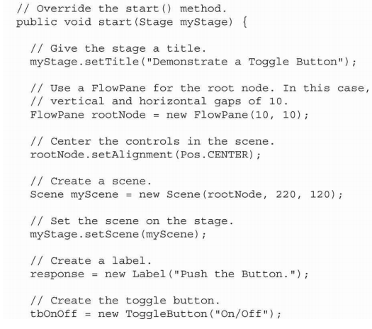

Slide 58
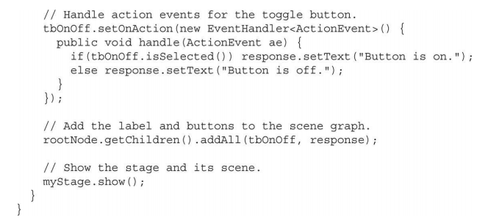
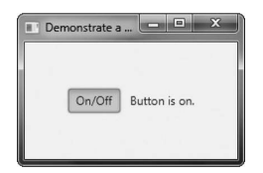

Slide 59
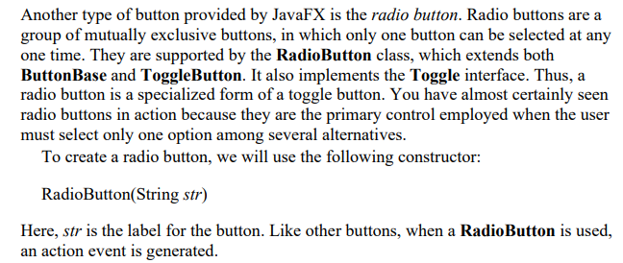
RadioButton

Slide 60
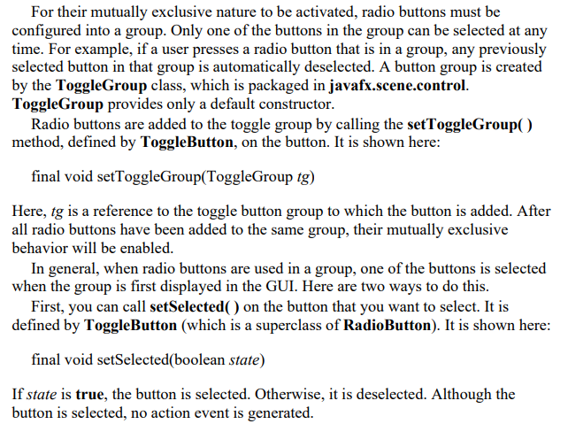

Slide 61
A second way to initially select a radio button is to call fire( ) on the button. It is shown here:
void fire( )
This method results in an action event being generated for the button if the button was previously not selected. There are a number of different ways to use radio buttons. Perhaps the simplest is to simply respond to the action event that is generated when one is selected. The following program shows an example of this approach. It uses radio buttons to allow the user to select a type of transportation.

Slide 62
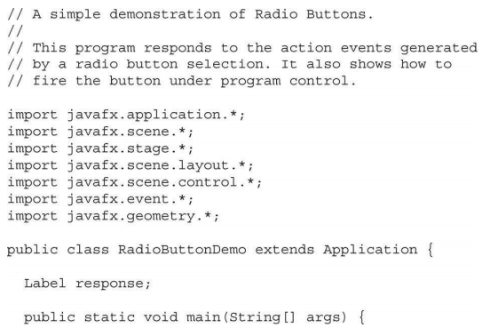

Slide 63
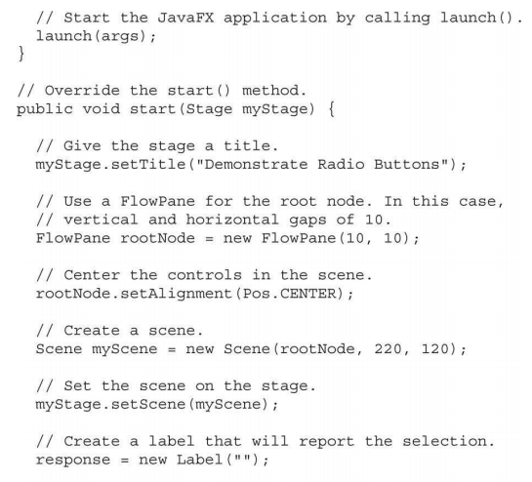

Slide 64
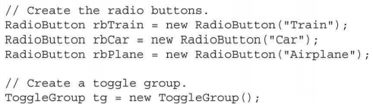

Slide 65
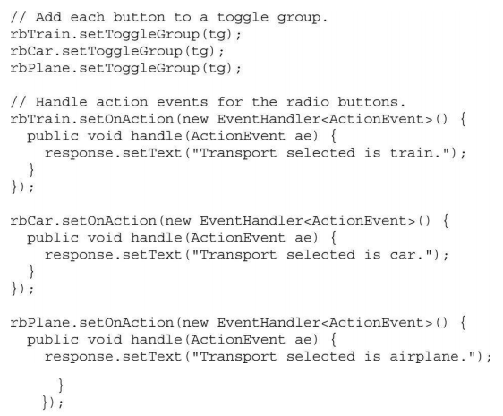

Slide 66
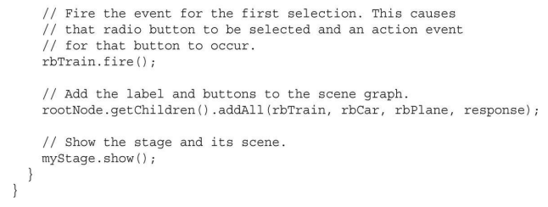


Slide 67



Slide 68


Slide 69



Slide 70


Slide 71


Slide 72


Slide 73



Slide 74


Slide 75


Slide 76


Slide 77


Slide 78


Slide 79


Slide 80


Slide 81


Slide 82
The columns value is used by TextField to determine its size. You can set the text in a text field by calling setText( ). You can obtain the current text by calling getText( ). In addition to these fundamental operations, TextField supports several other capabilities that you might want to explore, such as cut, paste, and append. You can also select a portion of the text under program control. One especially useful TextField option is the ability to set a prompting message inside the text field when the user attempts to use a blank field. To do this, call setPromptText( ), shown here:
final void setPromptText(String str)
In this case, str is the string displayed in the text field when no text has been entered. It is displayed using low-intensity (such as a gray tone). When the user presses enter while inside a TextField, an action event is generated. Although handling this event is often helpful, in some cases, your program will simply obtain the text when it is needed, rather than handling action events. Both approaches are demonstrated by the following program. It creates a text field that requests a search string. When the user presses enter while the text field has input focus, or presses the Get Search String button, the string is obtained and displayed. Notice that a prompting message is also included.

Slide 83


Slide 84


Slide 85


Slide 86



Slide 87


Slide 88


Slide 89


Slide 90


Slide 91


Slide 92


Slide 93



